Slide 1
Putting Passion Into Your Programming
By Jason Barrett

Slide 2
A GREAT Sports Radio Host Must Be Able To Commit Robbery
NOTE:
To change images on this slide, select a picture and delete it. Then click the Insert Picture icon
in the placeholder to insert your own image.
You Are Trying To Steal Two Things From The Audience:
Their TIME
Their CHOICE

Slide 3
What Makes Sports Radio Interesting?
Drama….Drama….Drama
Spectacular Storytelling
Real Time Conversations That Can’t Be Duplicated
Unique Viewpoints & Observations on Multiple Angles
Strong Informed Opinions That Stir Emotions & Are Unpredictable & Sometimes Uncomfortable
Timely & Impactful Props That Compliment The Talk Show’s Presentation
Audience Participation

Slide 4
What Fundamentals Help Drive Ratings?
Identify Content With The Broadest Appeal
Stay Within The Parameters of Your Clock
Dive Into Each Segment With a Plan & Purpose
Tease ONE Thing To Break & Pay It Off Immediately
Lead With Your Opinion, Support With Information

Slide 5
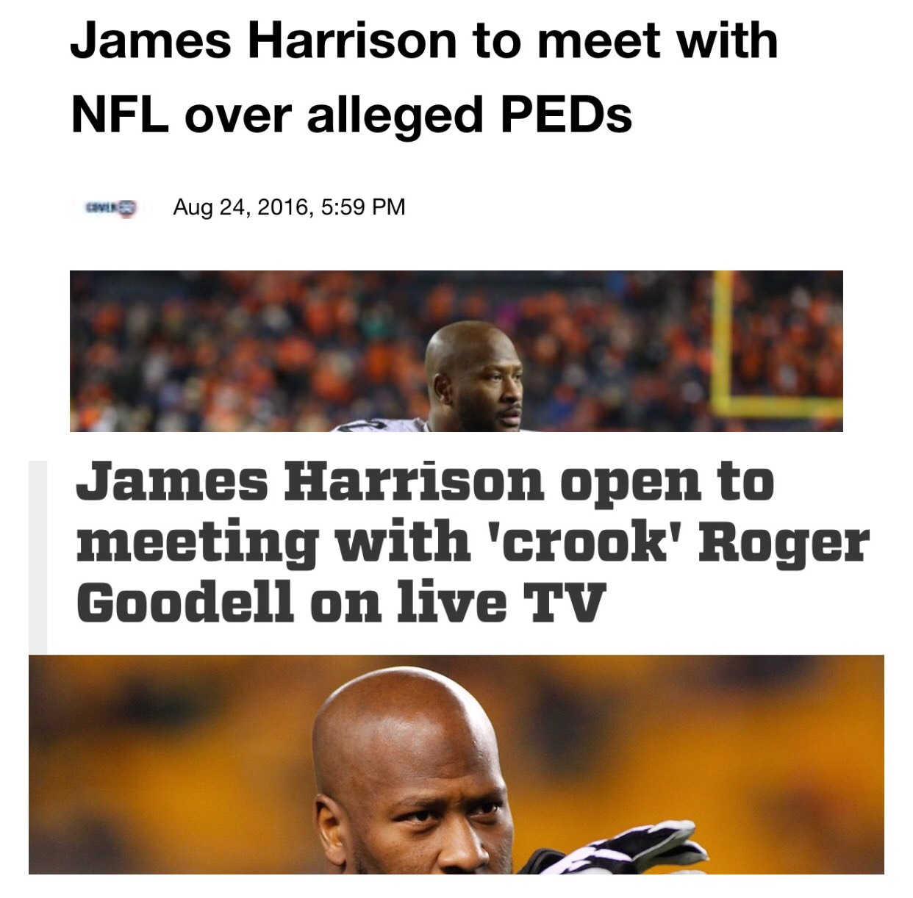
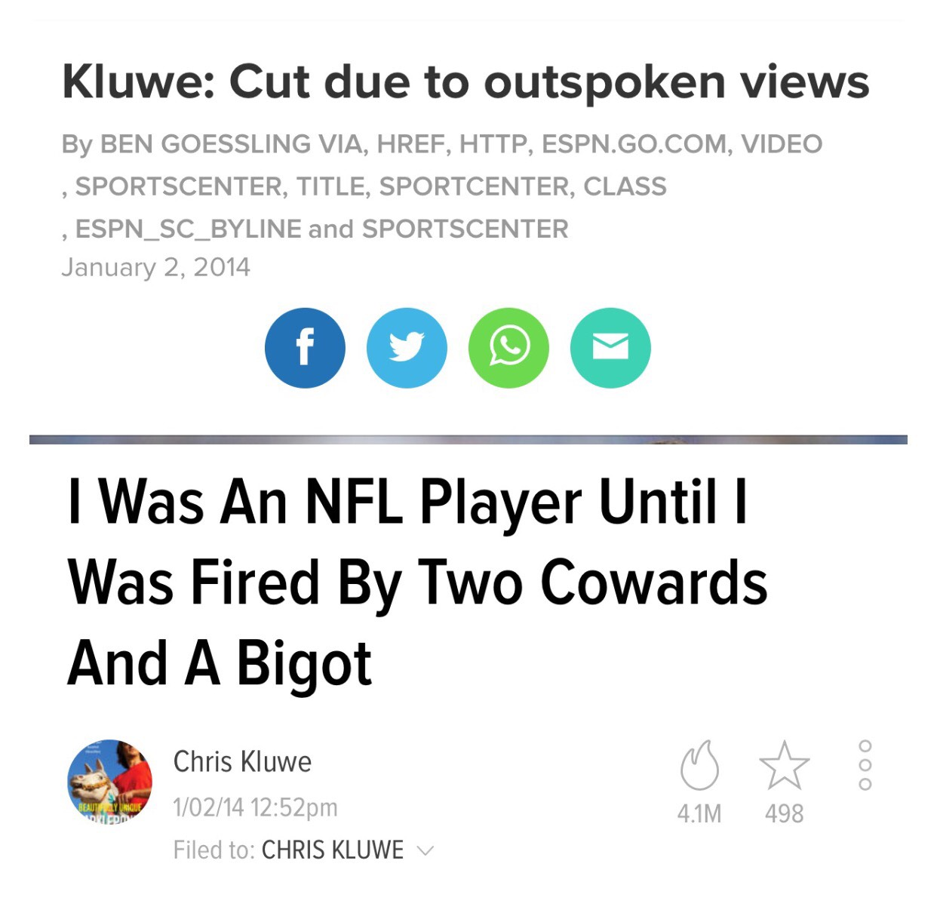
Leading With Opinion vs. Information

Slide 6
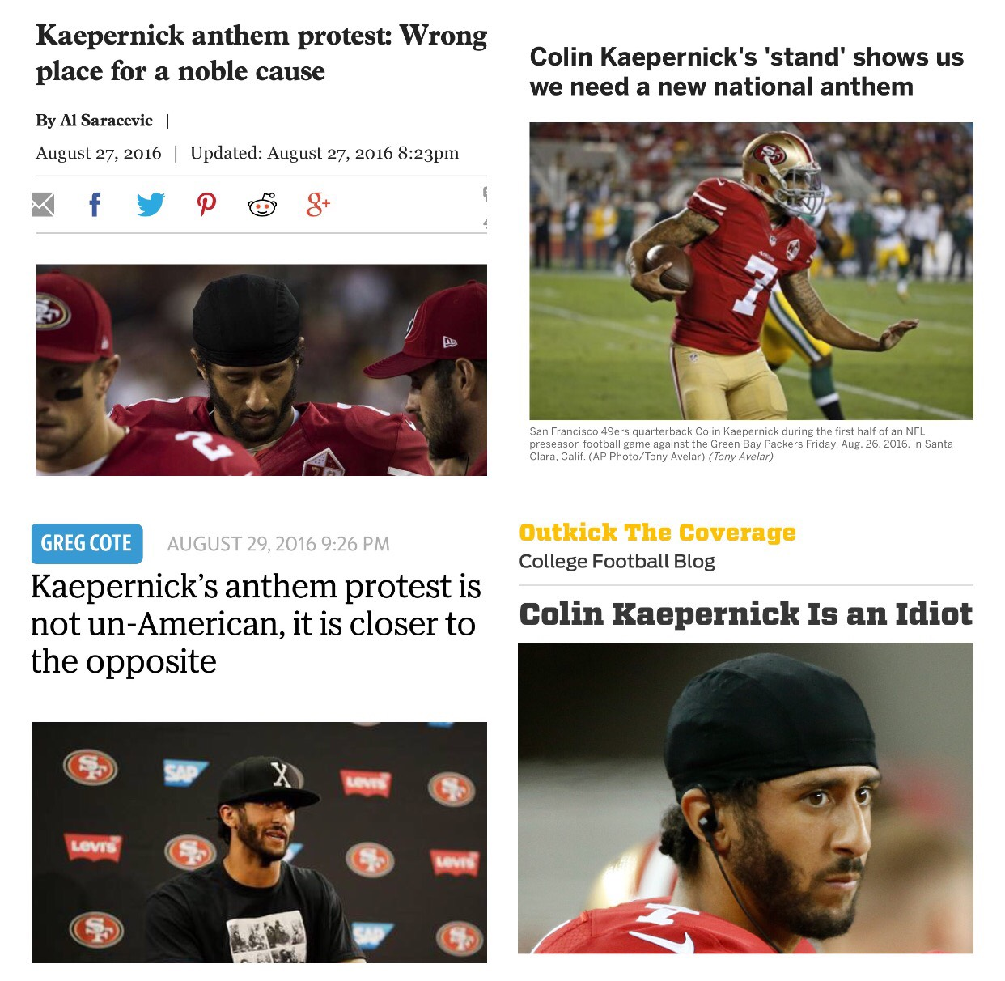
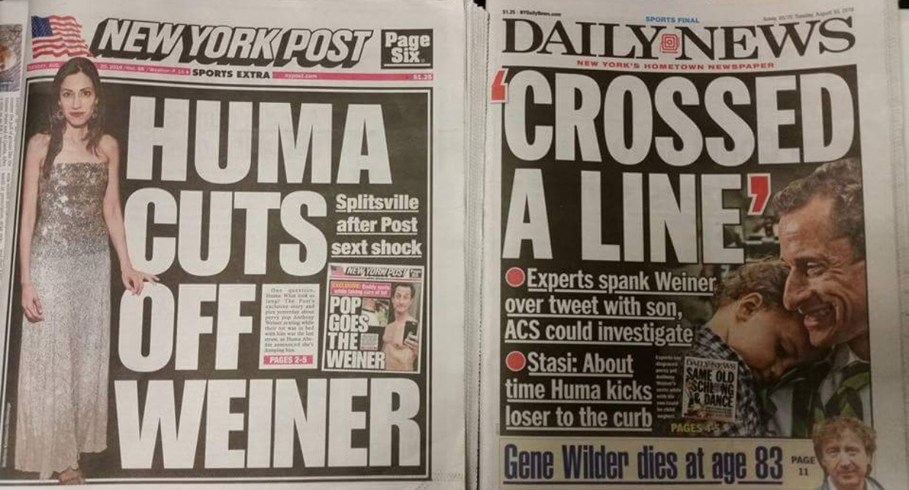
Leading With Opinion vs. Information

Slide 7
So What Does It Sound Like?
Mike Valenti -- 97.1 The Ticket

Slide 8
How Can You Program With Passion?
Research Your Audience
Identify Your Competitor’s Weaknesses
Develop a Multi-Platform Content Strategy
Coach Your Talent Consistently
Analyze Your Ratings In-Depth
Always Be Scouting & Talking To New Talent

Slide 9
Final Takeaways!
Your Goal Is To Steal The Listener’s Time & Choice
Select Material That Has Broad Appeal & Includes An Element of Drama
Lead With Opinion, Support With Information
Master The Basics & Execute Them Consistently
Always Evaluate Your Strategy & Performance

Slide 10
Jason Barrett
(845) 458-8448
@SportsRadioPD
JBarrett@sportsradiopd.com
http://sportsradiopd.com

